Slide 1

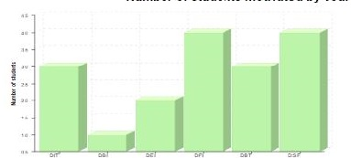
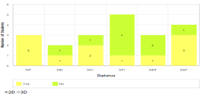
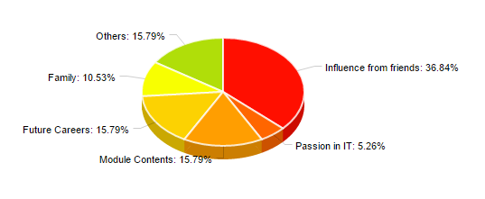
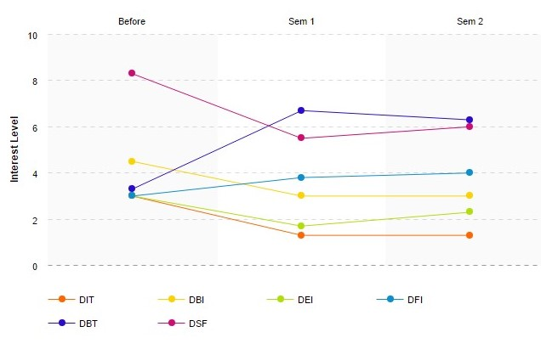
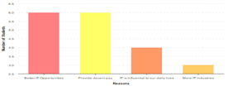
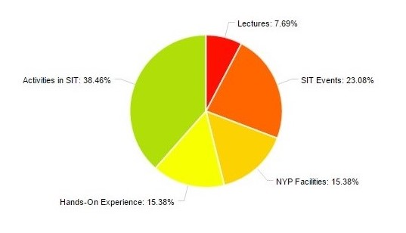
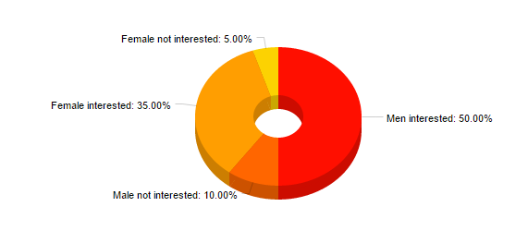
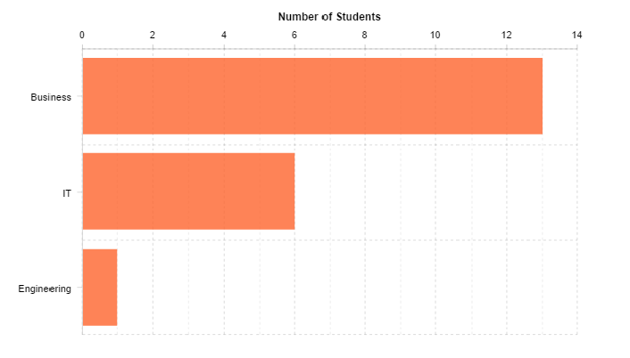

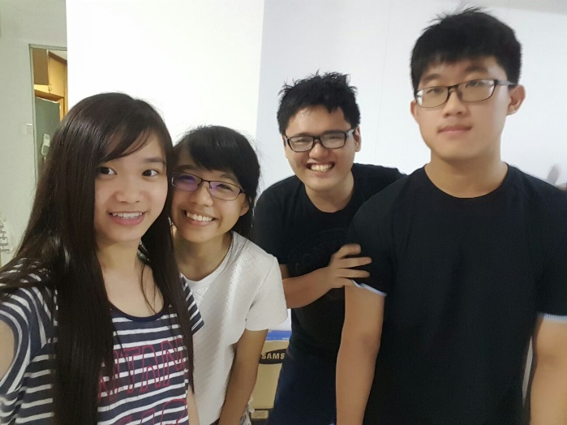
Project Objectives
Pure Insanity
To find out the motivation and reasons on why Year 1 students joined NYPSIT, whether is by choice or other alternatives.
Insight Dashboard
Number of students motivated by course relevance
Number of Y1 students interested working in IT sector
Reasons why Y1 students join NYPSIT
Interest Level for motivated students
Diploma in Financial Informatics and Diploma in Cyber Security and Forensics has the highest number of students motivated to join NYPSIT in terms of course relevance. However, Diploma in Engineering Informatics and Diploma in Business Informatics has the least number of students motivated to join NYPSIT by courses relevance.
Most students from the diploma in Information Technology and diploma in Cyber Security and Forensics would consider going into IT sector. However there are also a minority of students from these two diplomas want to change their field of study as they feel that they have made the wrong choice.
Year 1 students choose to join NYPSIT due to various reasons. Reasons such as influence from friends, module contents and future careers are likely to be the few main factors that cause students to join NYPSIT. However, from the data discovered, the main factor for the students’ choices would be influence from family.
DSF, DBI, DIT and DEI students who are motivated are interested in the first place, but their interest rate dropped as the time goes. (No motivation)
On the other hand, DBT and DFI students who are motivated have no interest at the beginning, but they sudden feel interested currently. (Motivation)
Reasons to work in IT sector
Reason of Motivation in SIT
Percentage of male and female students that are and are not interested in IT sector
Students interested in the different field studies
Students normally come into an IT course as they feel that they will be able to receive decent salary and better job opportunities once they enter into the workforce. However, a minority of them think that the growing number of IT industries is the reason that they chose an IT course.
From the data discovered, there are more male than female students who are interested in IT. It could then be hypothesized that IT related courses are generally more appealing to males.
Majority of people motivated because of activities in SIT and hands-on experience.
With this, these are the ways to make more people motivated in the future:-
- Plan more activities related to coding
- Conduct class activities like quiz games.
- Conduct more practical
- More hours on practical
It is evident that majority of the students are more interested in taking courses with Business. Nevertheless, our results have also shown that fewer students are interested in Engineering studies as compared to the other two studies.
Team Details:
Aw Aun Yeow (152899E)
Tan Jun Long (151176T)
Chong Yan Qing (154466H)
Gan Wan Tian Mabel (151477X)

